Slide 1
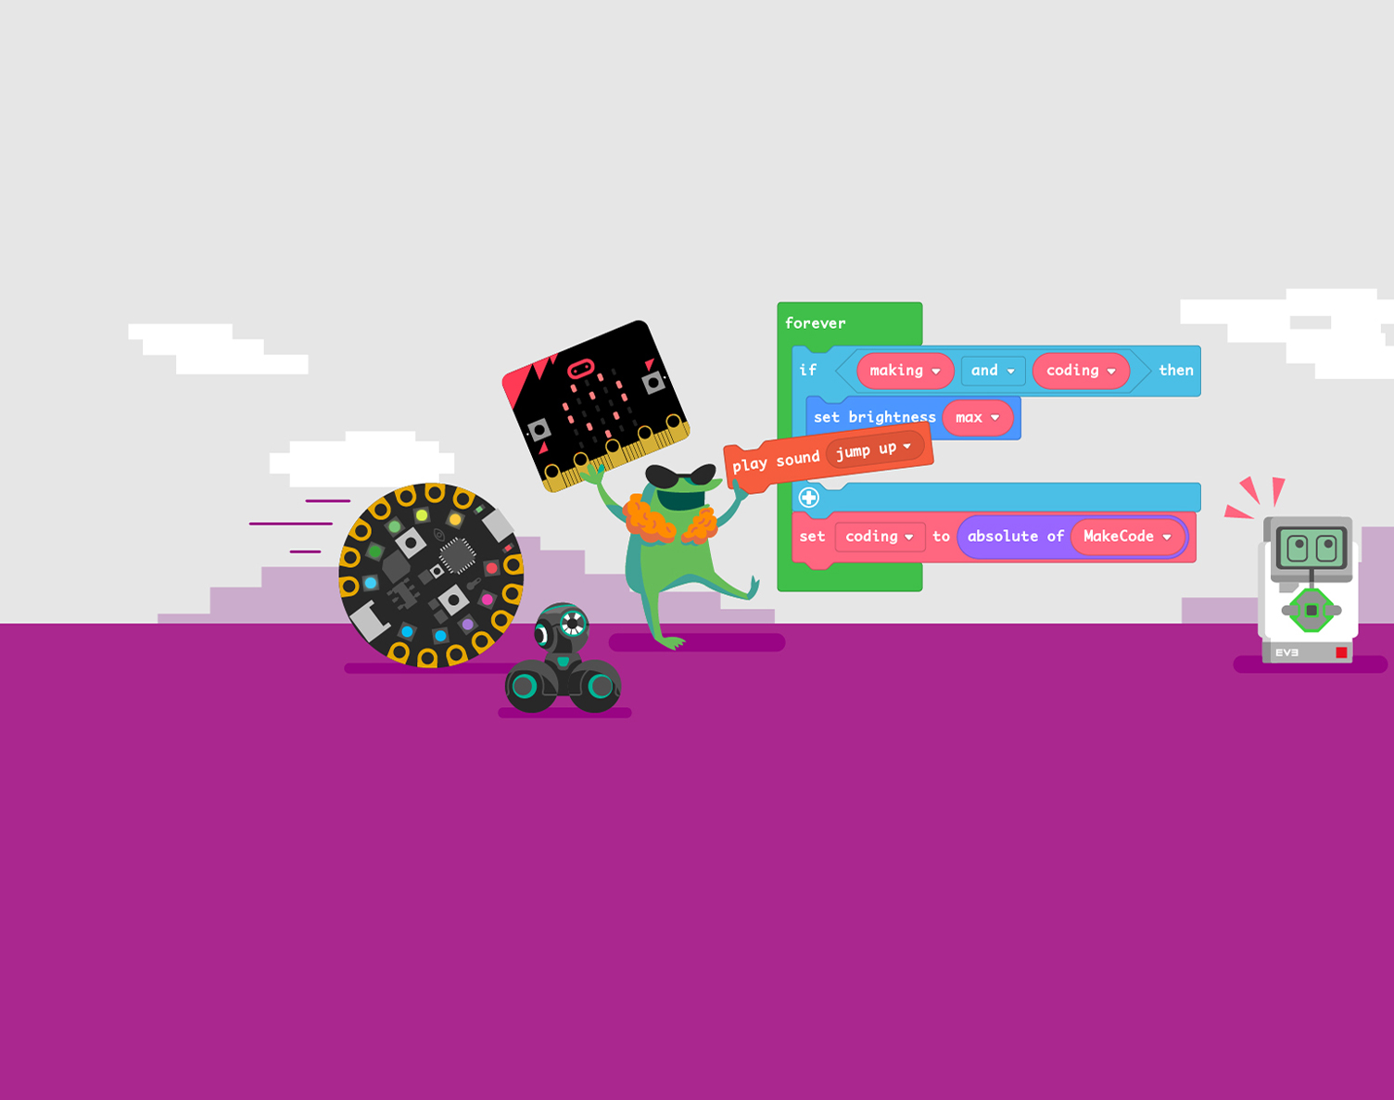
Computer Game Coding Camp 2021 Presentations

Slide 2
Presentation Script
Each person say your name and where you are from.
One person tells us the name of your game.
Another person tells us a 2-sentence summary of your game.
One person plays the game to the class while screen sharing.
The other person on your team narrates what is happening.
Each person on the team must report the following:
What is the coolest part of your game?
What part are you most proud of?
What part was almost too challenging to finish?
What part was so hard to understand in the beginning, but now it’s obvious to you?
Solicit feedback from others in the class
Each person from other teams in the class has to say 1 nice thing they like about the game and 1 thing to change to make the game better.

